Slide 1
Xamarin
General introduction

Slide 2
Xamarin
Microsoft API for mobile applications
Android
iOS
Windows
C# programming language
Visual Studio IDE

Slide 3
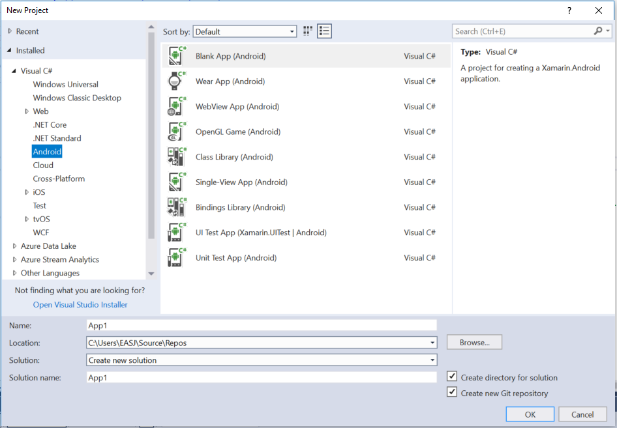
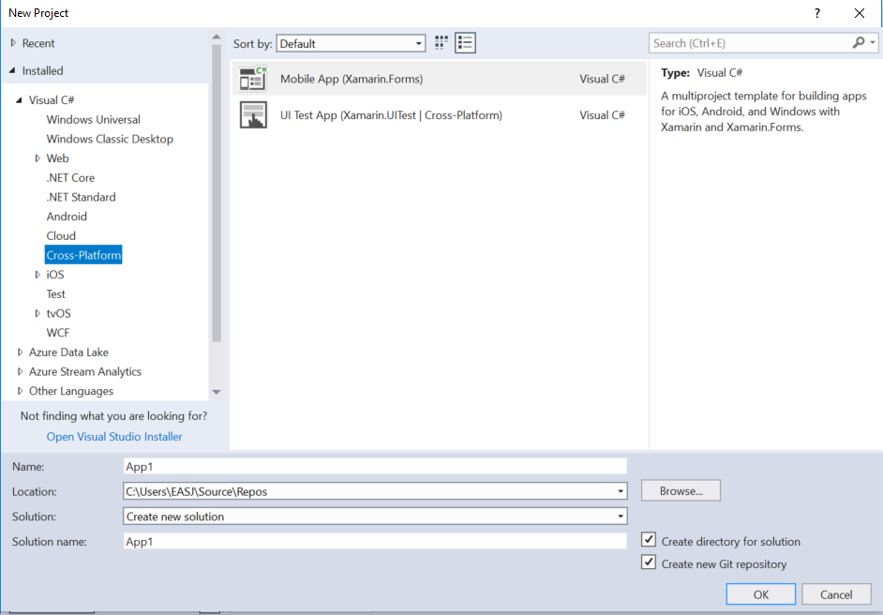
Native vs forms
Native
The application will run on ONE platform
Android, iOS or Windows
Xamarin Forms
The application will run on several platforms
Cross platform

Slide 4
Xamarin history
2011 started
2016 bought by Microsoft

