Slide 1
Intro to TypeScript

Slide 2
JavaScript (JS)
A browser
Renders HTML + CSS
Runs JavaScript
Since 1995
Some of syntax is Java-like
JavaScript makes web pages appear dynamic
JavaScript can manipulate the HTML DOM
Weakly typed programming language
Multi-paradigm
Object-oriented (prototype based), functional, etc.
Later versions are formally called ECMAScript (ES)
ECMA = European Computer Manufactorers Association

Slide 3
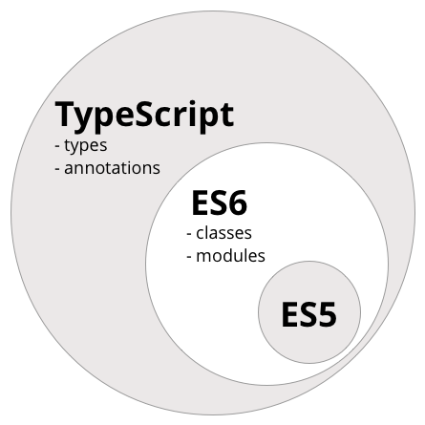
TypeScript
Since 2012
Anders Hejlsberg (DK), Microsoft
Open Source
TypeScript is a superset of JavaScript
TypeScript = JavaScript + more syntax
TypeScript is a better JavaScript
Stronger typing, better classes, etc.
TypeScript is compiled (transpiled) to JavaScript
Browsers run JavaScript (not TypeScript)

Slide 4
A little syntax
let name: string = ”Anders”;
The type is written AFTER the variable name
Keyword ‘let’ is used for declaration
function plus(a: int, b: int): int { return a + b; }

