Slide 1
RESTful web services

Slide 2
WebInvoke vs. WebGet
http://www.codeproject.com/Articles/255684/Create-and-Consume-RESTFul-Service-in-NET-Framewor

Slide 3
XML vs. JSON

Slide 4
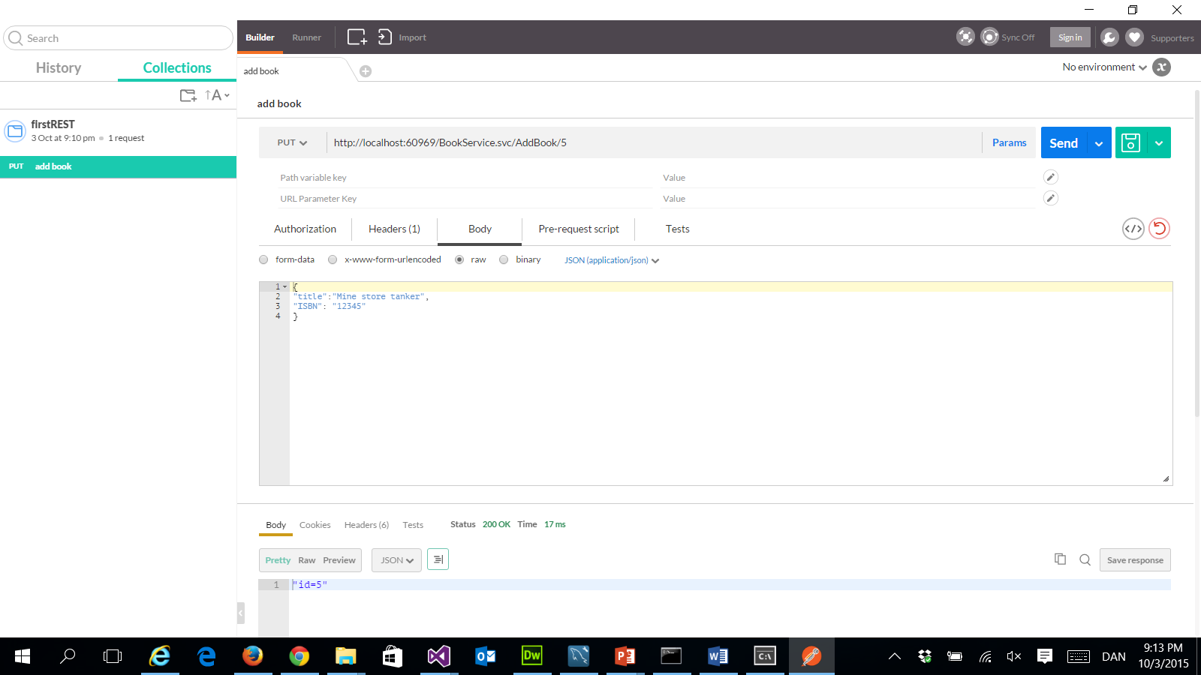
Postman

