Slide 1
Interfaces

Slide 2
Interfaces are (parts of) contracts
Interfaces are contracts between implementers and consumers
Consumers: Programmers using a class implementing the interface
The interfaces specifies the syntax of methods, etc.
But not the semantics
Missing: Class invariants, pre- and post-conditions, etc.
It is not the full contract!!
Example: LayeredLibrary, IRepository
The interface IRepository defines an contract between the upper layers (GUI etc.) and the lower layers (database, file, etc.) in the application.
Example: Producer-Consumer, IBuffer

Slide 3
Defining an interface
public interface ISomeName {
void Method1(); // no body
int Method2(String a); // no body
}
Naming convention
Names of interfaces usually start with the letter ‘I’
Example: LayeredLibrary

Slide 4
Implementing interfaces
Public class A : ISomeInterface {
// implement ALL the methods, etc. from the interface
// The compiler check that the class implements ALL the methods
}
The colon should be read as “implements”
A class an implement any number of interfaces
Bu only extend one other class
The more interfaces a class implements, the more contracts the class must fulfill
More methods in the class …
Example: The class List<T> implements 8 interfaces

Slide 5
Interfaces vs. inheritance
Inheritance means ”is a”
Example class Teacher : Person
Teacher is a Person.
Base class describe what an object is
Interfaces means ”behaves like”
Example class Teacher : IComparable<Teacher>
Teacher behaves like an IComparable
A Teacher object is comparable to other Teacher objects
Interface describe one way in which it behaves

Slide 6
Implementing multiple interfaces
“By using interfaces, you can, for example, include behavior from multiple sources in a class.”
http://msdn.microsoft.com/en-us/library/ms173156.aspx
In C# there is no multiple inheritance of classes.
List<T> implements 8 interfaces.

Slide 7
What you can have in an interface
Method signatures
No body
Properties declarations
No body

Slide 8
What you cannot have in an interface
No fields
No constructors
No access modifiers
All method are implicitly public
Nothing static
No nested types
No struct, enum, class, or interface inside an interface
No inheritance
However, you can extends other interfaces
Meaning extending another “contract”
Adding to the “contract”

Slide 9
Some popular interfaces
IDisposable
One method: void Dispose()
Object implementing this interface can be used in a using statement
Using (someDisposable) { …. }
IEnumerable<T>
Object implementing this interface can be iterated with a foreach statement
One method: IEnumerator<T> GetEnumerator()
Extended by other interfaces like Collection<T>
IEnumerator<T>
Property: Current
Methods: MoveNext, etc.
Collection<T>
Implemented by many collections
Extended by many other interfaces like IList<T>
IList<T>
Implemented List<T>

Slide 10
Interface vs. abstract class vs. class: The “Body” Rule
Interface
No methods have a body
An interface is more abstract than an abstract class!
No-body
Abstract class
Some methods have a body, some methods do not have a body
Some-body
Class
Every method have a body
Every-body

Slide 11
Implementation hierarchy: Partial implementations
Interface, class, abstract class
Example: Buffers from Producer-Consumer
Interfaces defines common behavior
Classes implement this behavior
Different classes can do different implementations
Duplicate code in the implementations can be refactored into an Abstract base class
The abstract class implements some of the methods from the interface
Interface IBuffer { ... }
Class AbstractBuffer : IBuffer {
Class BoundedBuffer : AbstractBuffer { … }
Class UnboundedBuffer : AbstractBuffer { … }

Slide 12
Single-method and zero-method interfaces
Single-method interface
Usually a delegate type is better
Example: ThreadStart
Zero-method interface
Aka. Marker interface
Usually annotations are better
Example: Unit testing [TestClass], [TestMethod], etc.

Slide 13
Dogma rule: Every class should have an interface
Every class should be defined by an interface.
The interface should be public
The class should not be public
The interfaces should be used everywhere possible
That is everywhere in the program, except after the keyword “new”
The use of “new” can be hidden through the use of a “factory”
Inspiration: Dogma 95
http://en.wikipedia.org/wiki/Dogme_95

Slide 14
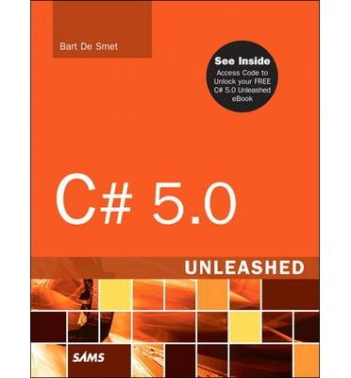
References and further readings
MSDN Interfaces (C# Programming Guide)
http://msdn.microsoft.com/en-us/library/ms173156.aspx
MSDN interface (C# Reference)
http://msdn.microsoft.com/en-us/library/87d83y5b.aspx
John Sharp: Microsoft Visual C# 2013, Step by Step, Microsoft Press 2012
Chapter 13 Creating Interfaces and Defining Abstract Classes, page 295-323
Bart De Smet: C# 5.0 Unleashed, Sams 2013
Chapter 14 Object-Oriented Programming
Interface Types, page 690-699

