Slide 1
Delegates in C#

Slide 2
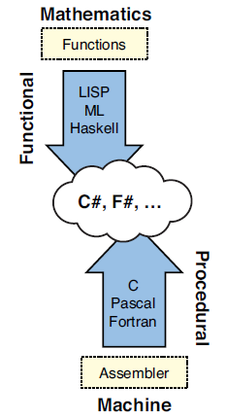
Functions
Pure mathematical function
Input –> function -> output
Same input = same output
No side effects
Methods in programming can have side effects
Example: Set I properties changes the state of an object
Bard De Smet: C# 5.0 Unleashed, Sams 2013: Language evolution in a broader perspective, page 791

Slide 3
What are delegates?
Delegates enable you to represent a function as an object
Delegates are types in C#
Like classes, structs, enums, etc.
Syntax (for declaring delegate types)
delegate returnType Name(parameters)
delegate int BinaryOperation(int a, int b)
Example: DelegatesTrying
Syntax (for instantiating delegate types)
int Plus(int a, int b) { return a + b; }
BinaryOperation operation = Plus
operation += Minus;
Syntax (calling)
int result = operation(4,5);

Slide 4
Some popular delegates types from the C# API
Delegate void ThreadStart()
No parameters, returns void
Used in class Thread
Constructor Thread(ThreadStart start)
Delegate void Action<T>(T obj)
This delegate type is generic
On parameter of type T, returns void
Used in List.ForEach(Action action)
Delegate void Action<T1, T2>(T1 obj1, T2 obj2)
Two parameters, returns void
Delegate TResult Func<out TResult>()
This delegate type is generic!
No paramters, returns TResult.
Out: TResult is an output parameter (there is more to out)
Delegate TResult Func<in T1, in T2, out TResult>(T1 obj1, T2 obj2)
Delegate bool Predicate<in T>(T obj)

Slide 5
Lambda expressions
New feature in C# 3.0
Simplified way to write anonymous functions
Including references to the closure
Lambda expressions makes it simpler to instantiate delegates
Example: i => i % 2 == 0
Reads: i goes to …
Left hand side: parameter
Right hand side: an expression
Example: DelegatesTrying -> LambdaExample
Example: ExtensibleCalculator

Slide 6
Closures: Captured outer variables
Lambda expressions can refer to outer variables
Called the closure
Foreach (int i in Enumerable.Range(0, 10) {
new Thread(() => Console.WriteLine(i)).Start();
}
Might show each number more than once
The closure object of the delegate refers to the variable ‘i’ – and the value keeps changing.
Solution: Make a local variable inside the loop: int i2 = i;
Visual Studio: Right click the project (not the solution) and chose Properties
Example: DelegatesTrying

Slide 7
Combining delegates: MultiCastDelegate
All delegates are MultiCastDelegates
Can refer to a number of delegate instances
Example: DelegatesTrying -> BinaryOperations
Example: CountDownTimer

Slide 8
Delegate vs. single-method interface
A delegate is comparable to a single-method interface
Delegate requires less code.
Interface must be implemented by a class
Interface is more flexible
Can be extended

Slide 9
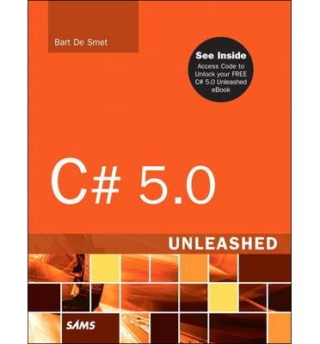
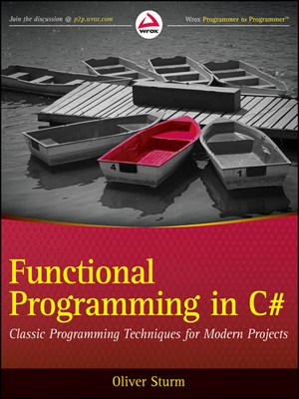
References and further readings
MSDN Delegates (C# Programming Guide)
http://msdn.microsoft.com/en-us/library/ms173171.aspx
Bart De Smet: C# 5.0 Unleashed, Sams 2013
Chapter 17 Delegates, page 789-842
Oliver Sturm: Functional Programming in C#, Wrox/Wiley 2011
Chapter 3 Functions, Delegates, and Lambda Expressions, page 17-30
Nagel et al. Professional C# 5.0 and .NET 4.5.1, Wrox 2014
Chapter 8: Delegates, Lambdas, and Events, page 183-208

