Slide 1
Testing REST services

Slide 2
Different kinds of tests
Testing types
Testing levels
Regression testing
Re-run old tests to check that old bucks has not come back
Alpha testing
Internal acceptance test
Beta testing
External acceptance test
Functional vs. non-functional testing
Performance testing
Usability testing
Is the user interface easy to use and understand
Security testing
Prevent hacking, etc.
Source
http://en.wikipedia.org/wiki/Software_testing#Testing_Types
Unit testing
Verify single component
Written by developers
White-box: Access to the source code
Integration testing
Verify interfaces between components
System testing
Verify completely integrated system
Acceptance testing
Users verify the system
Source
http://en.wikipedia.org/wiki/Software_testing#Testing_levels

Slide 3
Requirements for tests
Tests must be executable
A test must clearly show whether it executed successfully or not
The not-so-successful part of the test must not be buried in a pile of test reports.
Test code must be separated from the code to be tested
We normally don’t want to ship the test code with the production code.
Testing is not the same as trying!
If you make a main method it’s trying, not testing.
Trying … to see if you can make it work
Testing … to see if you can break it

Slide 4
Unit testing REST services
Test each method in each controller.
White Box
Test Code Coverage must be good
Example
StudentsRestStaticList

Slide 5
Testing REST services using Postman
With Postman you can try REST services.
Postman can also be used for testing
Automatic execution
clearly show whether it executed successfully or not
With Postman we test (or try) the REST interface of the service
Black box (no access to source code)
Test Code Coverage is not relevant

Slide 6
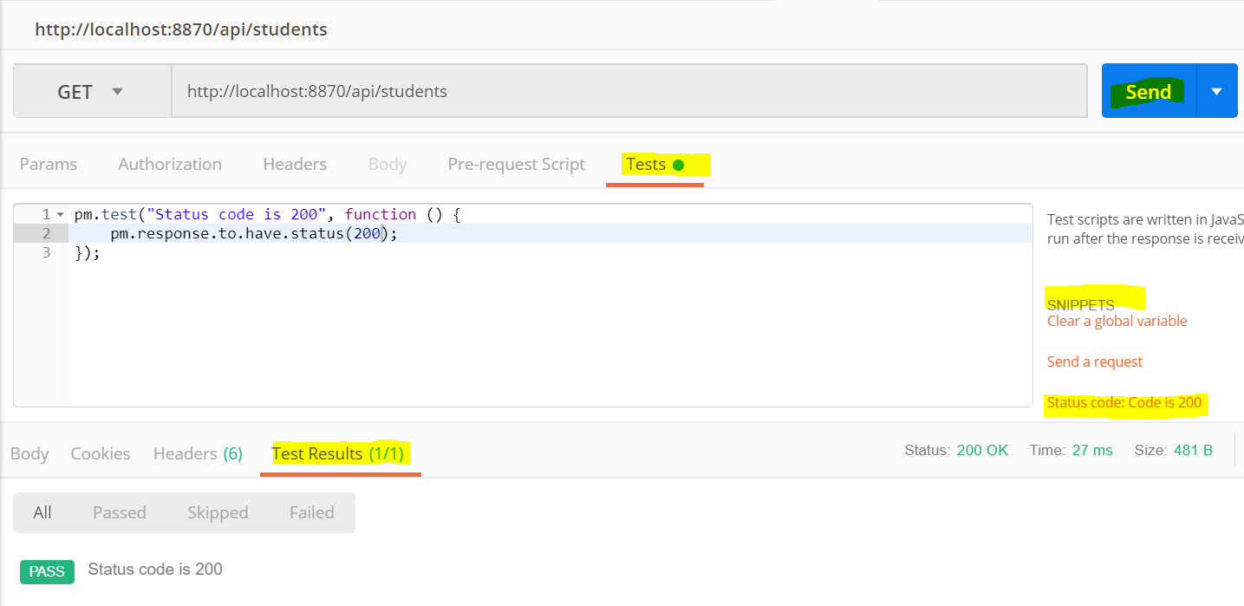
Tests in Postman
Tests are written i JavaScript
pm = Postman
Tests are executed AFTER the request
Press the Send button
The test examins the response header + body.
Snippets
Can help you write tests

Slide 7
Postman, example tests
GET http://localhost:25881/api/books
pm.test("Status code is 200", function () { pm.response.to.have.status(200);});
pm.test("Body matches string", function () { pm.expect(pm.response.text()).to.include("Benjamin");});
pm.test("number of elements", function() { pm.expect(pm.response.json().length).to.equal(3);});
pm.test("1st elements", function() { pm.expect(pm.response.json()[0].name).to.equal("Abraham");});

