Slide 1
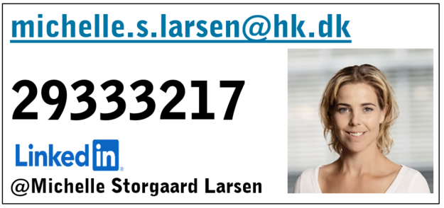
CONGRATULATIONS! SOON TO GRADUATE
Notes:
Congratulations for making it this far.
How are you holding up on your thesis? How were your internships?
Are you guys on LinkedIn? Please connect

Slide 2
What is important for you to know?

Slide 3
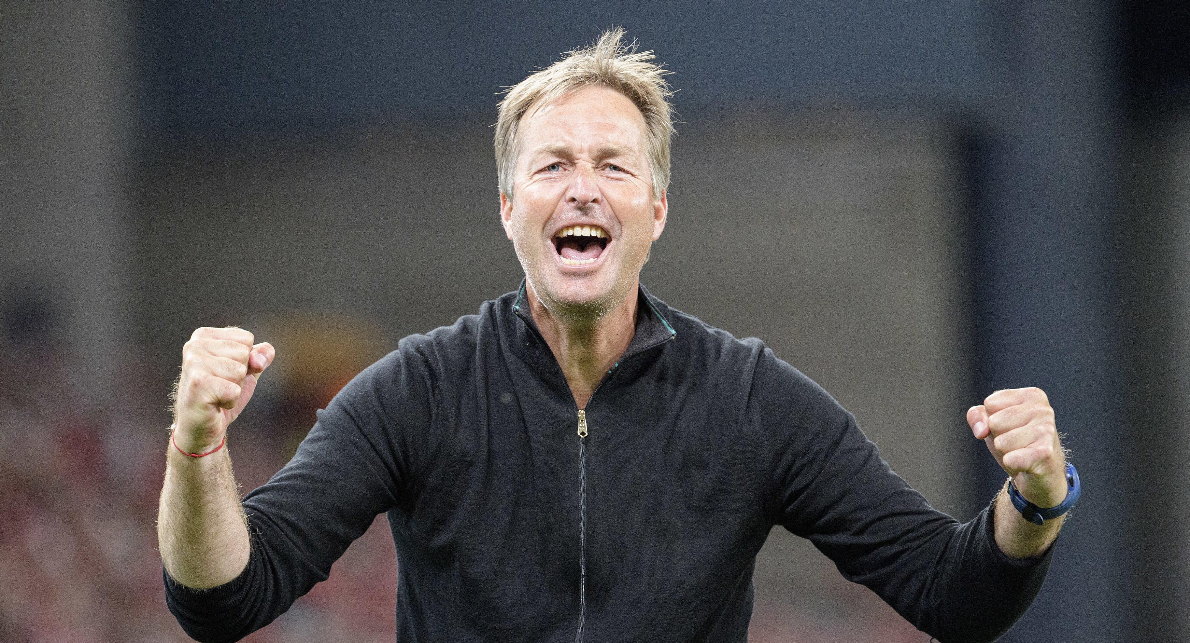
Notes:
Do you this man?
Head coach of the Danish men's national team in football and named leader of the year twice at the latest here in 2021
I have just attended a conference where Kasper Hjulman gave a presentation that I was very inspired by.
It made me want to try to do things a little differently today, so I hope you are in?
One of Kasper's most important points in relation to his success and leadership and what works was honesty. skinless honesty.
I am incredibly happy when your teachers reach out and invite me to be here as today and recognize the importance of you, as future graduates and employees, gaining knowledge about the labor market, the trade union, the unemployment insurance fund and your rights. Thank you for the invitation to Anders and Vibeke.
Maybe it's my job to stand here and tell you that you must be a member of a trade union. tell about all the cash benefits and offers there for our members.

Slide 4
10 reasons to join
The union for your profession
Legal assistance
Wage statistics
You get the first 4 months of the union for free
We offer advice in your future work life regarding job search, career development, employment and wages
Hundreds of online courses
Insurance offers
240.000 members that works in the same industry as you
Great offer on mobile subscription
Discount when shopping
Notes:
and present you with a list of at least 10 good arguments to convince you to become a member.
But no!
I do not even believe in it myself.
I do not believe that it is a list of membership benefits and offers that convinces you of a professional membership and as I said, I was inspired by Kasper Hjulman. Inspired to dare to be honest and open.
Therefore, I also want to do this the other way around.

Slide 5
Why do you think one should be a member of a trade union?
Notes:
I want you to tell me why you think it is important to a member the trade union?

Slide 6
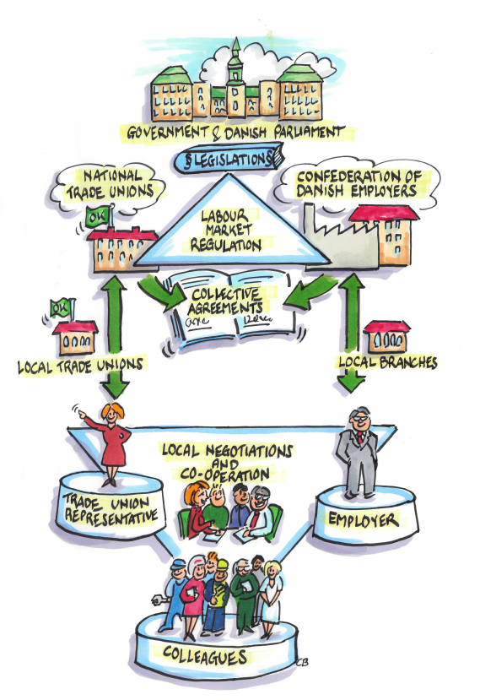
Flexicurity the Danish labour market model
Notes:
Flexicurity - the famous Danish labour market model - means that employers can easily hire and fire to adjust to the needs of the marketplace. At the same time, employees have a secure safety net in-between jobs.
Denmark's famous labour market model - Flexicurity - is widely admired for its ability to reflect the needs of employers while, at the same time, safeguarding the welfare of employees.
The model is based on a century of co-operation and has 2 core elements:
1. Being flexibility meaning flexible rules in regards to hiring and firing staff, which make it easier for the employers to scale down during slow times and hire new staff when things improve and also a long tradition of dialogue between employer associations and labour unions. The trade unions and the employers’ associations negotiate the collective agreements for each field of work, ensuring worker rights while also taking production and market conditions into account and the government rarely interferes.
For example, there is no legal minimum wage in Denmark. Instead, the relatively high wages are set as part of the regular negotiations between the employers and labour unions. Around 67 % of Danish workers are union members.
2. The second part is the unemployment security, in the form of guaranteed unemployment benefits.
Employees who join and pay subscription fees to an A-kasse (unemployment insurance fund) get up to two years' dagpenge (unemployment benefit) after losing their jobs.
hovedopgave er at skabe bedre løn- og arbejdsvilkår på arbejdspladserne. Og for at løse den opgave optimalt har vi brug for dig og dine kolleger. I kender jeres arbejdsplads og ved, hvad der fungerer rigtig godt allerede, og hvad der kan gøres bedre.

Slide 7
Trade unions with the OK mark secures you and all of us
Notes:
The OK mark is a seal of quality. Trade unions with the OK mark have a special knowledge of your profession and your industry. We ensure you good working conditions and a good working life by entering into agreements with the employers.

Slide 8
Collective agreement or law?
Working hours?
Overtime payment / payment for staggered working hours?
Minimum wage?
An extra week of holiday?
Paid leave on your child's first sick day
Vacation
Maternity leave with maternity benefit allowance or full pay
Free education and training of your choice
Savings for retirement
Notes:
37 hour working week. Promise no one. EU directive says 48 hours per. week over 4 months.
If you are at work when others are off, you're entitled to extra payment in your wage packet
Overtime payment for hours worked over the normal 37 hour working week and payment for working staggered hours and for working irregular work schedules
Minimumwage: Law = none. OK guarantees a minimum wage and a fixed wage increase
If your child has caught an infection in the nursery you have the right to paid leave on full pay on your child's first sick day
Vacation: Agreement: Five weeks holiday and a sixth holiday week. Often a holiday allowance that is higher than the statutory 1 percent.
Legislation: 5 weeks holiday and 1 percent special holiday allowance.
Maternity: When a baby is born parents have the right to share maternity leave between them. As a minimum you have the right to maternity benefit allowance during maternity leave. For the most part maternity benefit allowance is far below your normal salary. In some cases you may receive full pay during maternity leave
Education: You are entitled to participate in education and training of your own choice. In this way you can safeguard skills and qualifications for the future, so you will be an attractive employee and have a job the whole of your working life
Pension: Can you live on the state pension? There has got to be something more than that If you want a life as a senior citizen and be able to afford the pleasurable things in life. Together with the company where you are employed you pay into a pension scheme – a so-called labour market pension – which is then paid at regular intervals when you reach pensionable age. It is supplementary to the state pension

Slide 9
The job market for newly graduated computer scientist

Slide 10
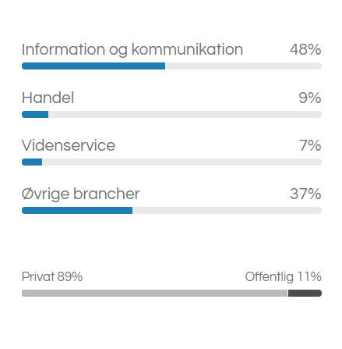
which industries graduated computer scientists work in
Were to look for jobs?
www.it-jobbank.dk/job/software-webudvikling
www.hk.dk/karriere/jobboers
www.jobindex.dk/job/it
Did you know that the public sector is the largest provider of jobs in IT?
Notes:
Do not limit yourself to looking only for jobs in the private sector. There are lots of IT jobs in the public sector and there the competition is not as great.

Slide 11
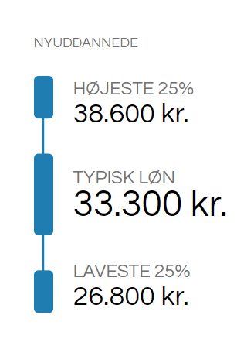
Average salary
Average salary for a computer scientist. Remember that salary depends on:
Job title
Level of responsibility
Experience
Collective agreement

Slide 12
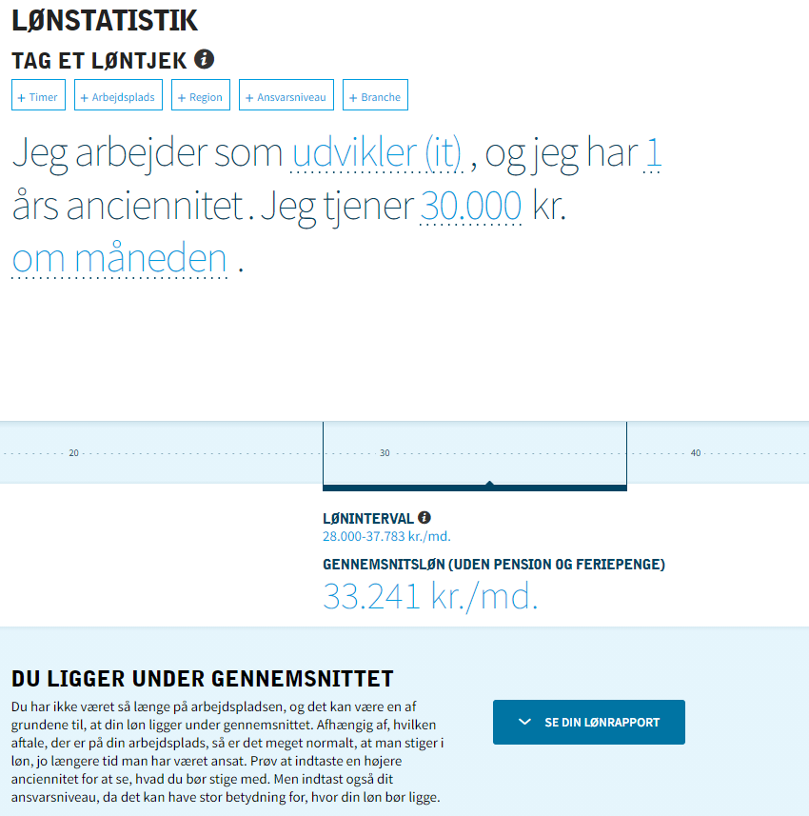

Slide 13
Unemployment benefits
A-kasse

Slide 14
13.836 dkk per month
I HAVE BEEN A MEMBER FOR AT LEAST 12 MONTH
GREAT! YOU ARE ENTITLED TO BENFITS THE DAY AFTER YOU GRADUATE
I AM NOT YET A MEMBER?
YOU CAN STILL MAKE IT!
IF YOU SIGN UP TODAY YOU CAN OBTAIN BENEFIT ONE MONTH AFTER GRADUATION
Notes:
As a recent graduate you must enroll no later then 14 days after your latest exam in order to bbe entitled to unemolyment benefits.

Slide 15
After graduation?
1. Apply for membership in HKs a-kasse - no later than 14 days after graduation (last exam)
2. Register with your local Job Center at jobnet.dk
3. Submit a Statement of Availability (ledighedserklæring) at mithk.dk
4. Confirm job search at least every 7 days at jobnet.dk
5. Within 2 weeks after you have declared yourself unemployed, you must add an active resume (CV) at jobnet.dk
These rules are decided by law and there are no exceptions.

Slide 16
Price overview AFTER GRADUATIONS
**Different alternativ
The prices are tax deductible
* Depends on choice of union
** Prosa Union combined with Min A-kasse: https://min-a-kasse.dk/wp-content/uploads/Min-A-kasse-Loenforsikring-Skema-2021.pdf

Slide 17
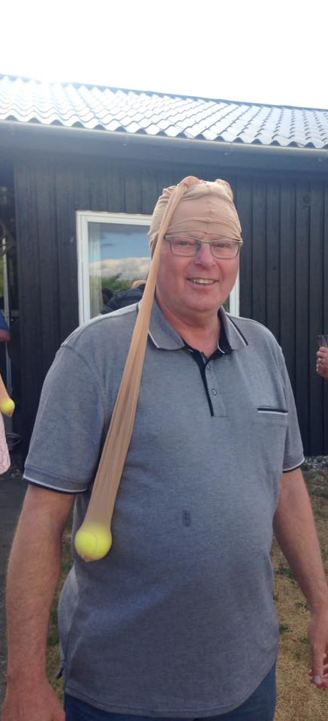

Slide 18
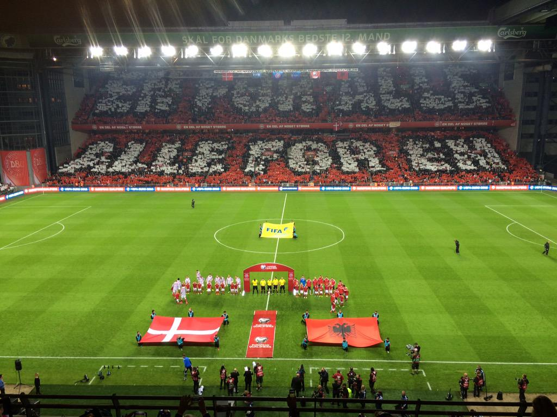
WISH TO JOIN?
ONLINE: www.hk.dk/omhk/about-hk
FILL A FORM
CALL US 7011 4545

Slide 19
Contact info
Union 7011 4545
A-kasse 7010 6789
Notes:
Are you guys on LinkedIn? Please connect

